Slide 1
ICT Multi-Media Lesson 2:
Using Multi-Media Software

Slide 2
Objectives
6.2.1: Describe graphics software and the ways it can be used.
6.2.2: Compare and contrast vector and bitmap images.
6.2.3: Identify image file formats for photos and graphical art (e.g., TIFF, BMP, EPS, JPEG, GIF, PNG), and specify which formats are supported on the Web.
6.2.4: Define terms related to the creation and display of graphical images (e.g., raster, vector, transparency, opacity, cropping, etc.).
6.2.5: Create images with effects using different tools, brushes, adjustments and filters available in graphics software.
6.2.6: Copy and paste graphical images.
6.2.7: Modify shapes and colors in a graphical image.
6.2.8: Save and export a digital photograph in a format that provides the best image quality and file size for Internet use.

Slide 3
Graphics & Graphics Software
Clip art is pre-made graphic images used to illustrate any medium.
A logo is an emblem, symbol, or graphic mark commonly used by organizations, associations, and commercial enterprises.

Slide 4
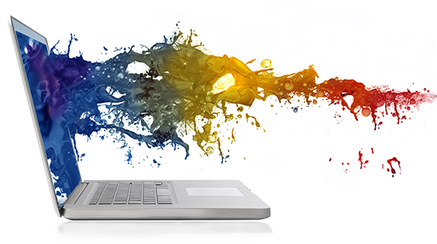
Graphics & Graphics Software
Web graphics are visual representations used on a Web site to enable or enhance the representation of a feeling or idea, in order to reach the Web site user. Web graphics include photographs, diagrams, designs and patterns, bar and pie charts, typography, line art, and many other image forms.
The background is the general scene or surface against which images, graphics, designs, or figures are represented or viewed.

Slide 5
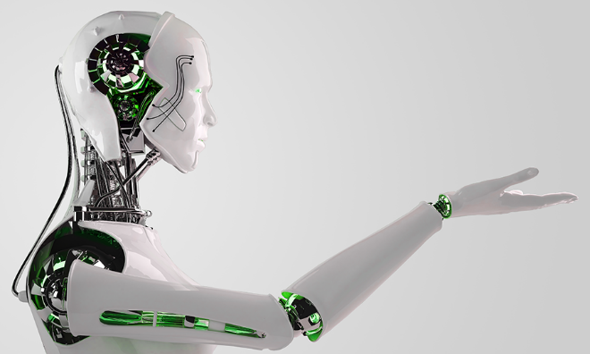
Graphics & Graphics Software
Graphics are used as a method of entertainment and communication:
product packaging,
magazine and book illustrations,
and art.
Graphics help add visual interest, grab attention and evoke emotions.

Slide 6
Graphics & Graphics Software
Common graphics software programs
Adobe Photoshop
CorelDRAW
and Pixlr.
Variety of tools and brushes
Represent traditional artistic styles
oils
acrylics
watercolors
charcoal
and pen.

Slide 7
Graphics Types
Raster
Vector
Made of grids of pixels, commonly referred as a bitmap.
The larger the image, the more disk space the image file will take up.
Becomes pixelated when enlarged
Not made up of a grid of pixels.
Mathematical formulas that draw lines and curves between points to create an image
A path can be a line, a triangle, a square, or a curvy shape.

Slide 8
Raster Graphics
 | Uses | Compression | Animation | Transparency
BMP (Bitmap) | Crisp clear original | No | No | No
JPG (JPEG) | Web and print photos | Lossy | No | No
GIF | Logos and drawings | Lossless | Yes | Yes
PNG | Line art, cartoons, logos, web photos | Lossless | Yes (APNG) | Yes
TIFF | Desktop publishing, 3-D, medical imaging | No
PSD | Adobe Photoshop |  | Yes | Yes

Slide 9
Vector Graphics
Used to create simple drawings or complex diagrams.
Can be enlarged to any size and not lose any image quality.
Ideal for logos, which can be large enough to appear on a billboard, yet small enough to appear on a business card.
Common types:
AI - Adobe Illustrator
EPS – common format that can be opened in multiple platforms
SVG – 2 dimensional and supports interactivity and animation
DRW – often used for technical drawings like construction or engineering

Slide 10
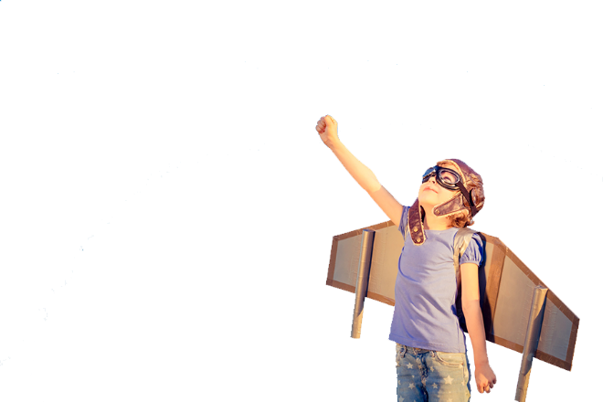
Transparency
The ability to see through an object
Can be partial or complete
Also used to refer to a graphic that does not have a background
Opacity: how transparent an object is – adjusted in the Tools palette

Slide 11
Resolution
The detail an image has
Only applies to raster (Bitmap) images – not vector
Measured:
DPI – dots per inch
PPI – pixles per inch
High resolution – 300 – 600 DPI
Photographs
Low resolution – 72 DPI
Web images

Slide 12
Pixlr

Slide 13
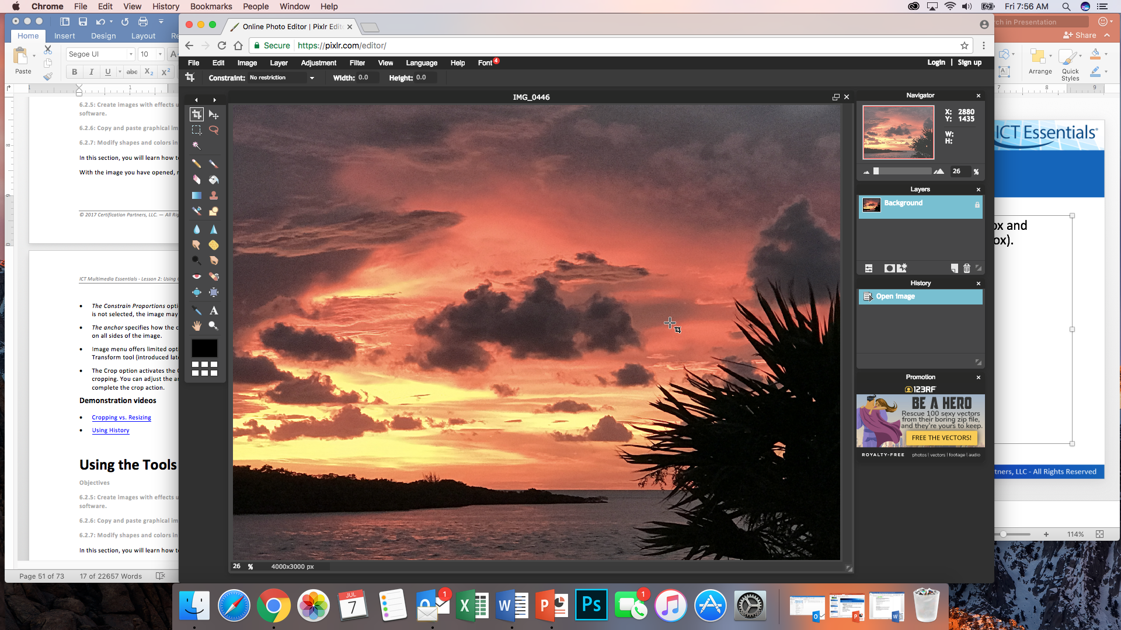
Digital Editing Software
Navigation panel - used to zoom in and out of the image and move around the image when editing
History panel – records actions and can be used to reverse changes (undo).
Navigator panel - zoom slider, zoom percent box and panning
Layers panel: used to create, delete and move layers, and contains layer styles.

Slide 14
Menus - Image

Slide 15
Image Menu
Canvas: adjusts the amount of space to edit outside the original image
Anchor: used with the canvas command
Specifies how the canvas is modified.
The middle box means an equal amount of canvas is added on all sides of the image.
Constrain Proportions: used to maintain width and height proportions when resizing.
Crop: removes an unwanted portion of the image.
Reduces file size

Slide 16
Tools Palette

Slide 17
Tools Palette

Slide 18
Layers
Can be thought of as a separate sheet of transparent paper.
Allows you to place objects separately and treat each one with unique filters or effects
Stacking: the order of the layers
Change order of layers to bring an object forward or move it back
Flatten: to merge all layers into a single layer

Slide 19
Layer Options
Toggle Layers
Add Layer Mask
Layer Styles
New Layer
Delete Layer

Slide 20
Adjustments
Modify
Brightness & Contrast
Hue & Saturation
Color balance
Vibrance

Slide 21
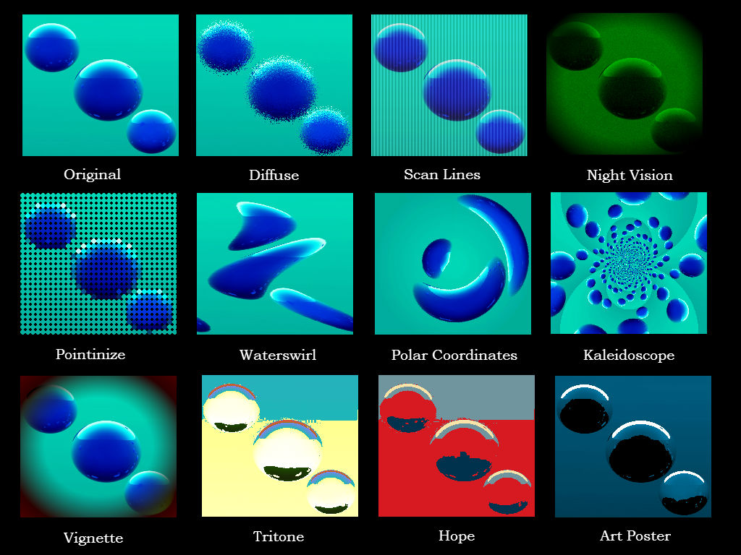
Filters
Graphical effects

Slide 22
Selection Tools
Magic Wand: makes a selection based on color and tone values that are similar to the area clicked
Lasso: selects an area as it is traced or outlined or based on diagonal lines
Marquee: selects an area based on a square (or rectangle) or a circle (or oval)
Marching Ants: outlines an area that has been selected by a dotted line

Slide 23
Editing Tools
Feathering: soft edge of an image when cropping or editing
Free Transform: used to rotate or resize an image
Blending Tools: Blur, Dodge, Sharpen
Clone: copy details of one area of an image and paste them in another area on the same image

